Slide 1
Microelectronics Processing
Chemical Vapor Deposition

Slide 2
Thin film deposition systems
CVD
PVD
Spin-on
Electrolytic deposition

Slide 3
CVD deposition
Chemical Vapor Deposition is the formation of a
non-volatile solid film on a substrate by the reaction
of vapor phase chemicals (reactants) that contain the
required constituents.
The reactant gases are introduced into a reaction
chamber and are decomposed and reacted at a heated
surface to form the thin film.

Slide 4
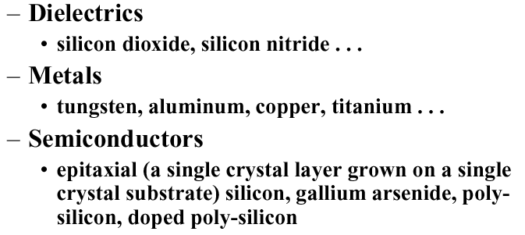
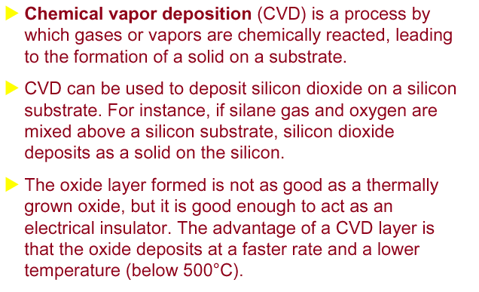
Examples of CVD films

Slide 5
CVD Systems
AP-CVD
LP-CVD
PE-CVD
HDP-CVD
PH-CVD (CVD writing)

Slide 6
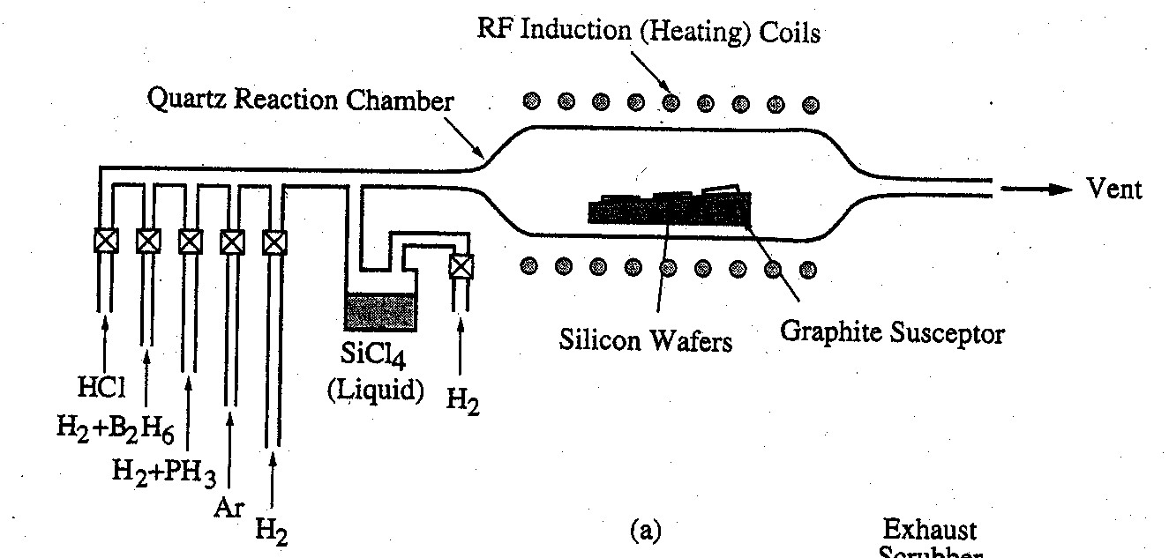
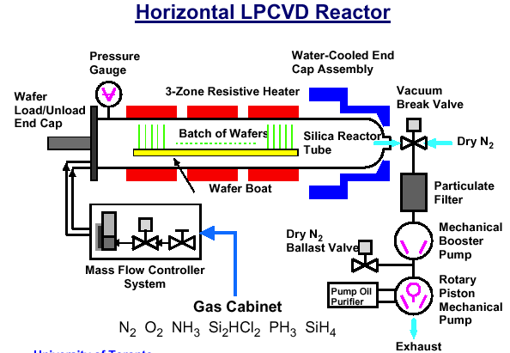
CVD systems
Horizontal APCVD Reactor

Slide 7
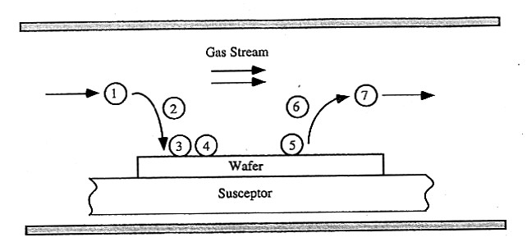
Steps involved in a CVD process (schematic)
1. Transport of reactants by forced convection to the deposition region.
2. Transport of reactants by diffusion from the main gas stream through the boundary layer to the wafer surface.
3. Adsorption of reactants on the wafer surface.
4. Surface processes, including chemical decomposition or reaction, surface migration to attachment sites (such as atomic-level ledges and kinks), site incorporation, and other surface reactions.
5. Desorption of byproducts from the surface.
6. Transport of byproducts by diffusion through the boundary layer and back to the main gas stream.
7. Transport of byproducts by forced convection away from the deposition region.

Slide 8
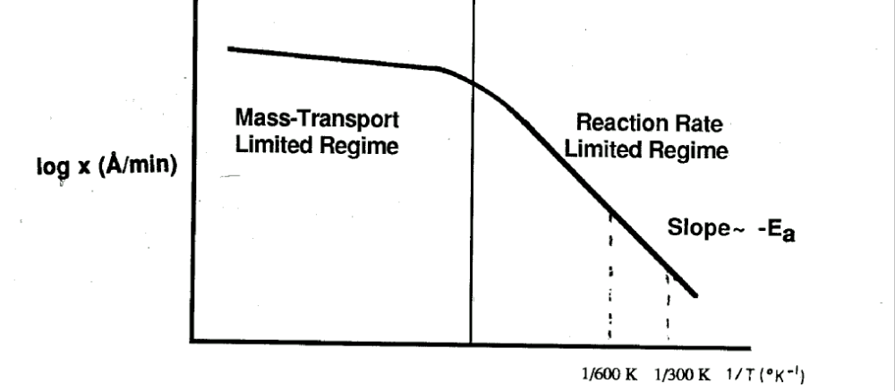
Steps involved in a CVD process (limiting processes)
Gas phase process (mainly diffusion to substrate).
Surface process (mainly reaction)

Slide 9
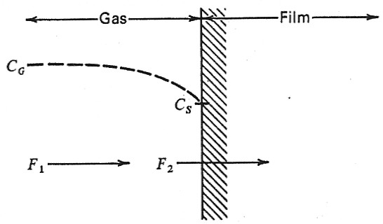
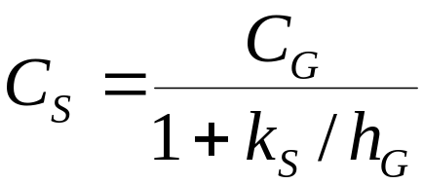
CVD kinetic growth model
We approximate the flux Fl by the linear formula
F₁ = h_{G}(C_{G} –C_{S})
where C_{G} and C_{S} are the concentrations of the SiCI₄ (molecules per cubic centimeter) in the bulk of the gas and at the surface, respectively, and h_{G} is the gas-phase mass-transfer coefficient.
The flux consumed by the chemical-reaction taking place at the surface of the growing film F₂ is approximated by the formula
F₂ = k_{S}C_{S}
where k_{S} is the chemical surface-reaction rate constant.
In steady state F₁ = F₂ = F. Using this condition, we get

Slide 10
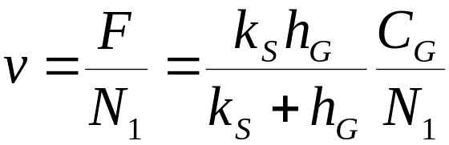
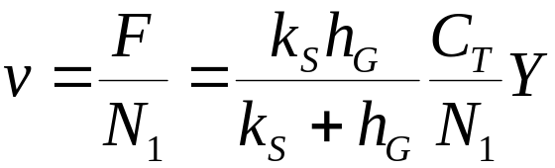

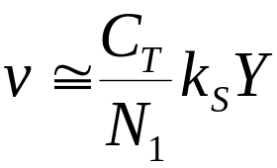
CVD kinetic growth model-II
We can now express the growth rate of the silicon film by writing
where N₁ is the number of silicon atoms incorporated into a unit volume of the film. Its value for silicon is 5.0×10²² cm⁻³. Noting that C_{G} = YC_{T} where C_{T} is the total number of molecules per cubic centimeter in the gas, we get the expression for the growth rate,
The growth rate at a given mole fraction is determined by the smaller of h_{G} or k_{S}. In the limiting cases the growth rate will be given either by
[surface-reaction control]
or by
[mass-transfer control].
h_{G}Y

Slide 11
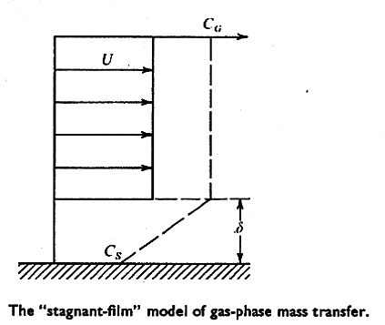
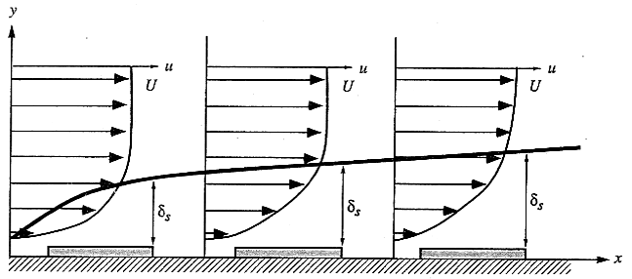
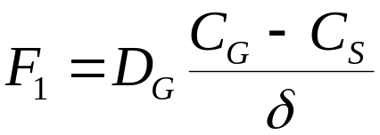
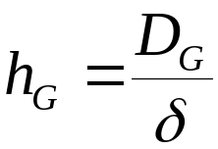
CVD growth model – Gas phase mass transfer
The “Stagnant-film” model of gas-phase mass-transfer
Boundary layer theory: δ increases with distance in the direction of gas flow (from Newton’s second low).
D_{G} – diffusivity of reactant species
δ - boundary layer thickness

Slide 12
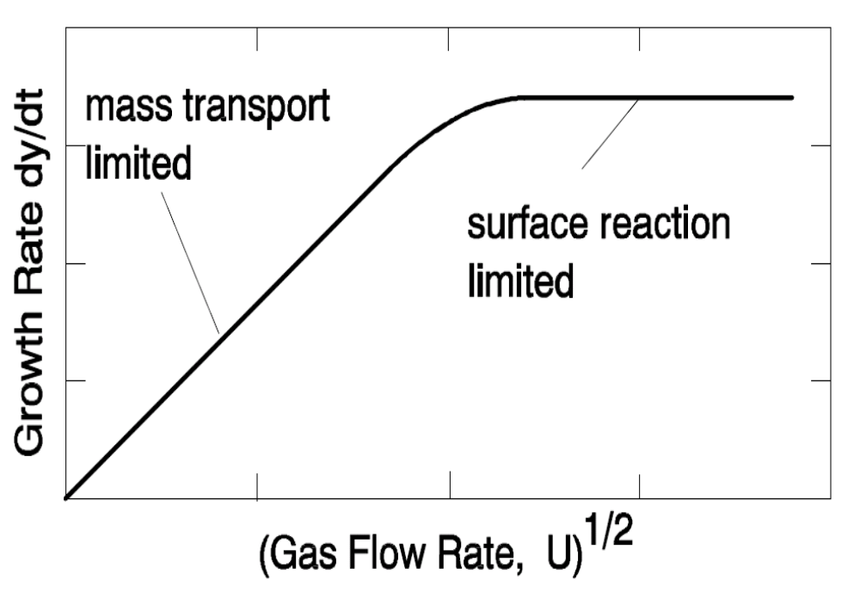
CVD growth model – Gas phase mass transfer
The flow of reactants F is F ∝ D_{G} δ⁻¹

Slide 13
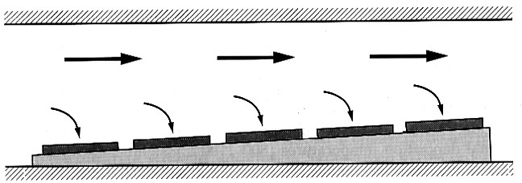
Tilted CVD susceptor
The susceptor in a horizontal epitaxial reactor is tilted so that the cross-sectional area of the chamber is decreased, increasing the gas velocity along the susceptor. This compensates for both the boundary layer and depletion effects.

Slide 14
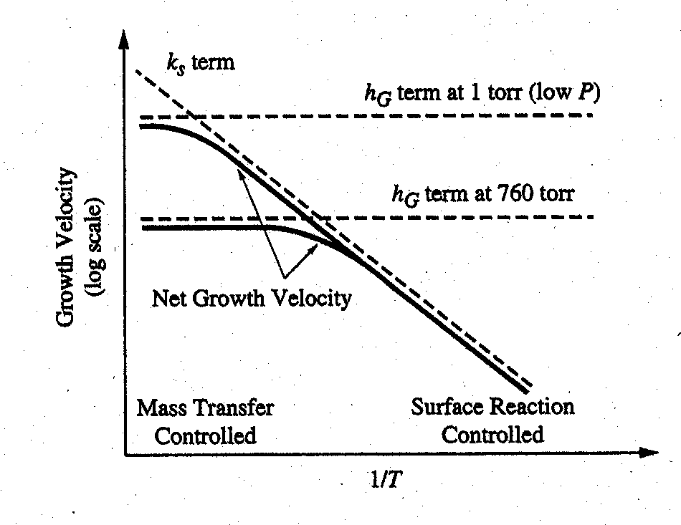
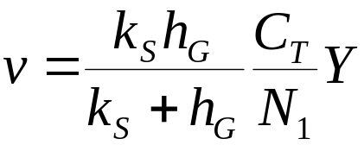
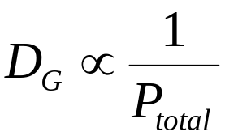
LP-CVD
Recall that
and
The key new point is

Slide 15
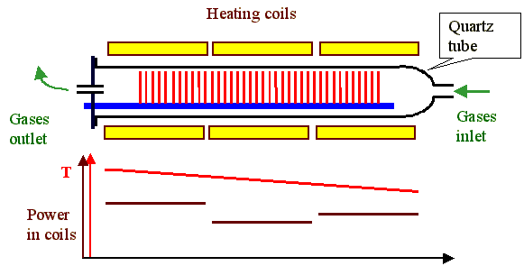
Gas depletion in LPCVD reactor
In the surface reaction limited regime
T is critical (1⁰C). Ramping T compensates
depletion.

Slide 16
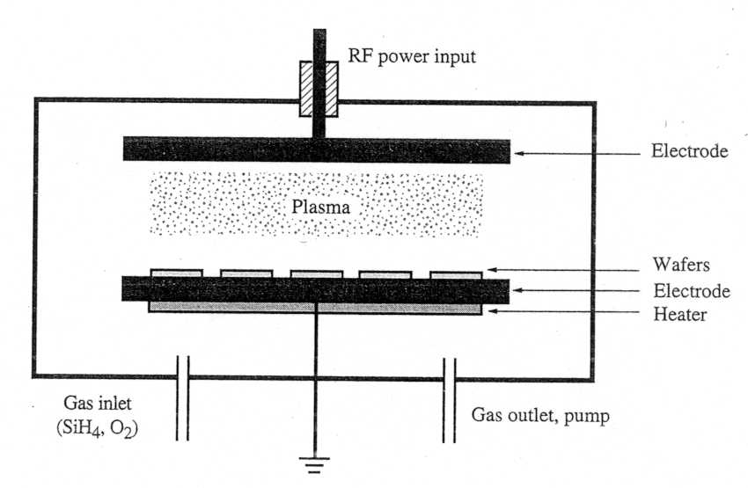
Plasma enhanced CVD system (PECVD)
As the thermal budget gets more and more constrained while more and more layers need to be added for multi-layer metallization, we want to come down with the temperature for the oxide ( or other) CVD processes.
One way for doing this is to supply the necessary energy for the chemical reaction by ionizing the gas, thus forming a plasma.

Slide 17
PECVD properties
Low substrate temperature
Conformal film
Not stoichiometric film
By-products incorporated
Outgassing
Cracking
Peeling

Slide 18
High Density Plasma CVD systems (HDP-CVD)
ECR
ICP
A separate RF bias sputtering planarization

Slide 19
CVD of Si - Epitaxy
When SiH₄ gas is used in a CVD reactor, a Si layer
is deposited on the wafer surface. The size of the
crystallites depends on the deposition temperature.
At high enough temperature, the ad-atoms have
enough kinetic energy to move on the surface and
align themselves with the underlying Si.
This is an epitaxial layer, and the process is called
Epitaxy instead of CVD.
At lower deposition temperatures, the layer is
poly-crystalline Si (consisting of small crystallites)

Slide 20
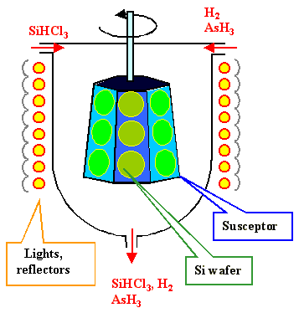
Si Epitaxy
The chemical reaction that produces the Si is fairly simple:
SiCl_{4(g)}+2H_{2(g)}=(1000-1200ºC)=Si_{(s)}+4HCl_{(g)}
Instead of SiCl₄ you may want to use SiH_{X}Cl_{4-X}

Slide 21
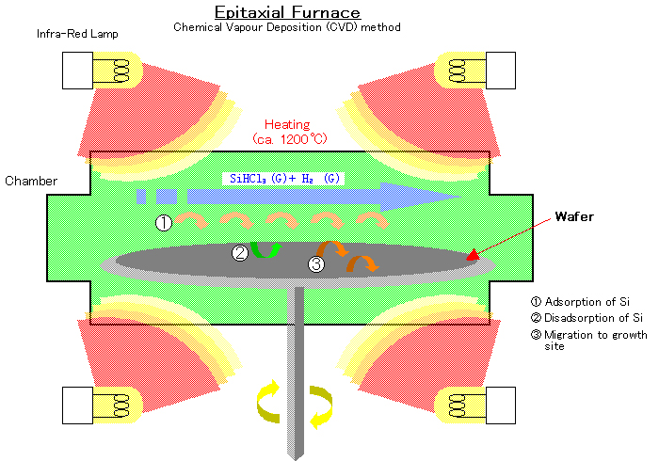
Epitaxial Furnace

Slide 22
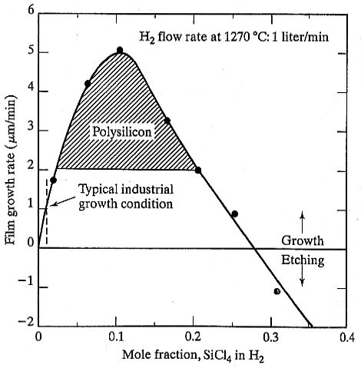
Effect of SiCl₄ concentration on Si deposition
Polysilicon deposition occurs for growth rates exceeding 2 μm/min. Etching of the surface will occur for mole fraction concentrations exceeding 28%.

Slide 23
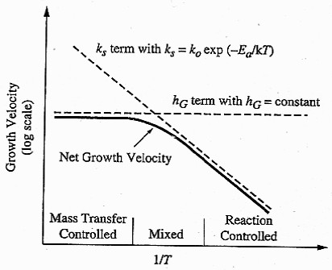
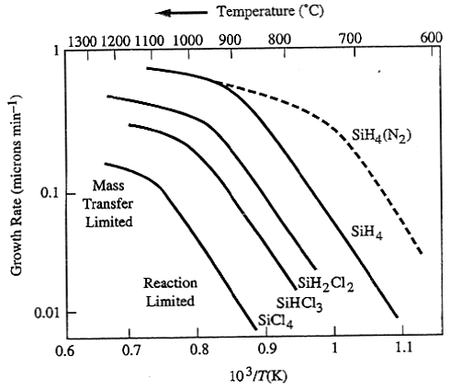
CVD kinetic growth model
Deposition rate vs. 1/T for Si deposited by APCVD using various source gases. Partial pressure of the reactant gas was 0.8 torr. H₂ used as carrier gas for solid curves. Using N₂ as diluent shifts SiH₄ curve to the right.
Arrhenius plot of growth velocity vs. 1/T for CVD process

Slide 24
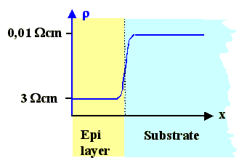
Si epitaxy – controlling doping profiles
Epitaxy is definitely needed if a doping profile is required where the resistivity in regions near the surface is larger than in the bulk. By diffusion, you can always lower the resistivity and even change the doping type, but increasing the resistivity by diffusion is not realistically possible.

Slide 25
Examples for CVD Processes Used in Semiconductor Manufacturing
Layer
Reaction equations
Temperature (ºC)
SiO₂
LTO
TEOS
HTO
SiH₄ + O₂ -> SiO₂ + 2H₂
Si(OC₂H₅)₄ -> SiO₂ + gas.RP
SiCl₂H₂ + N₂O -> SiO₂ + 2N₂ + 2HCl
SiH₄ + CO₂ H₂ -> SiO₂ + gas.RP
400-450
650-700
850-900
850-950
Si₃N₄
3SiH₂Cl₂ + 4NH₃ -> Si₃N₄ + 6HCl + 6H₂
700-900
Polysilicon
SiH₄ -> Si + 2H₂
600-650
Tungsten
selective
blanket
2WF₆ + 3Si -> 2W + 3SiF₄
WF₆ + SiH₄ -> W + SiF₄ + 2HF + H₂
300
400-450

Slide 26
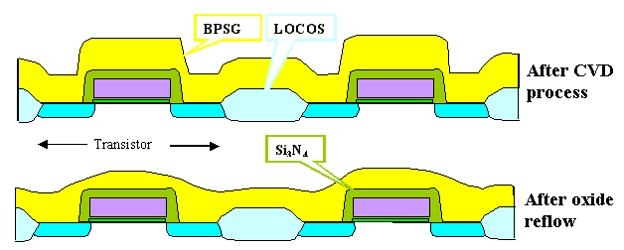
Oxide CVD
There are several possibilities, one is
SiH₂CI₂ + 2NO₂ = (900 °C) = SiO₂ + 2HCI + 2N₂
While this reaction was used until about 1985, a better reaction is offered by the "TEOS" process.
Si(C₂H₅O)₄ = (720 °C) = SiO₂ + 2H₂O + C₂H₄.
Si(C₂H₅O)₄ has the chemical name Tetraethylorthosilicate

Slide 27
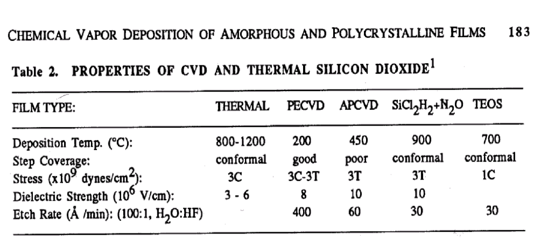
Oxide CVD

Slide 28
Si₃N₄ Deposition
We don't "nitride" the Si, analogous to oxidations, by heating the Si in a N₂ (actually we do - on occasion), because Si₃N₄ is so impenetrable to almost everything - including nitrogen - that the reaction stops after a few nm. There is simply no way to grow a "thick" nitride layer thermally.
Also, don't forget: Si₃N₄ is always producing tremendous stress, and you don't want to have it directly on the Si without a buffer oxide in between. In other words: We need a CVD process for nitride.
Well, it becomes boring now:
Take your CVD furnace from before, and use a suitable reaction, e.g.
3SiH₂Cl₂ + 4NH₃ =(...ºC)= Si₃N₄ + 2HCl + 1,5 H₂.

Slide 29
Tungsten (W) CVD
Ironically, W-CVD comes straight form nuclear power technology: High purity Uranium (chemical symbol U) is made by a CVD process using UF₆ as the gas that decomposes at high temperature.
W is chemically very similar to U, so we use WF₆ for W-CVD.
A CVD furnace, however, is not good enough anymore. W-CVD needed its own equipment, painfully (and expensively) developed a decade ago.
We will not go into details, however. CVD methods, although quite universally summarily described here, are all rather specialized and the furnace type reactor referred to here, is more an exception than the rule.

Slide 30

Advantages of CVD processes
CVD processes are ideally suited for depositing thin layers of materials on some substrate. In contrast to some other deposition processes which we will encounter later, CVD layers always follow the contours of the substrate: They are conformal to the substrate as shown below.

Slide 31
Disadvantages of CVD processes
The two most important ones (and the only ones we will address here) are:
They are not possible for some materials; there simply is no suitable chemical reaction.
They are generally not suitable for mixtures of materials.

